Slide 1


AUTOMATED
INTERVIEW PROCESSING SYSTEM
24-25J-047

Slide 2

INTRODUCTION
Traditional interview methods often fail to capture the complete picture of a candidate's capabilities and personality.

Slide 3

RESEARCH PROBLEM
Current interview processes are often subjective and limited in scope, failing to provide a holistic assessment of candidates.
There is a need for an automated tool that integrates multiple evaluation techniques to offer a comprehensive and objective analysis of candidates' capabilities and suitability for roles.

Slide 4
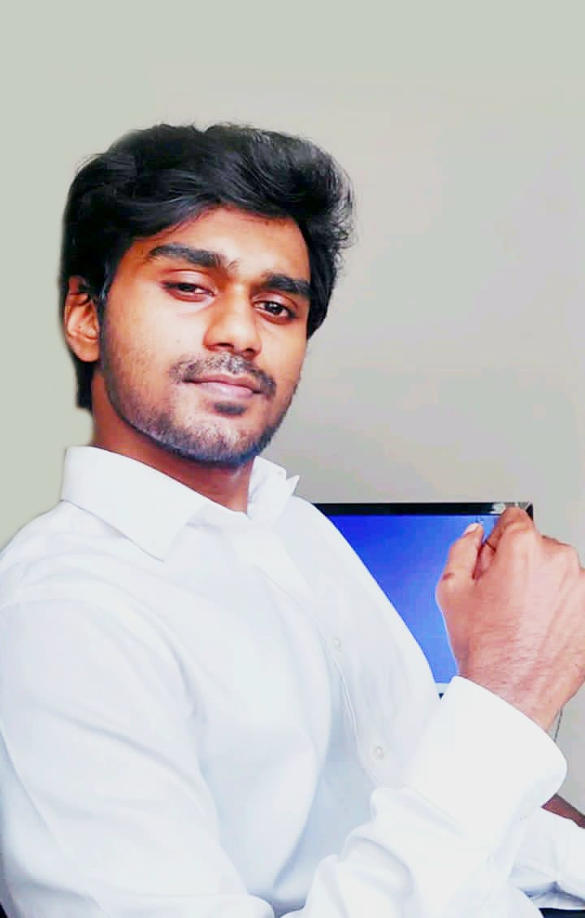
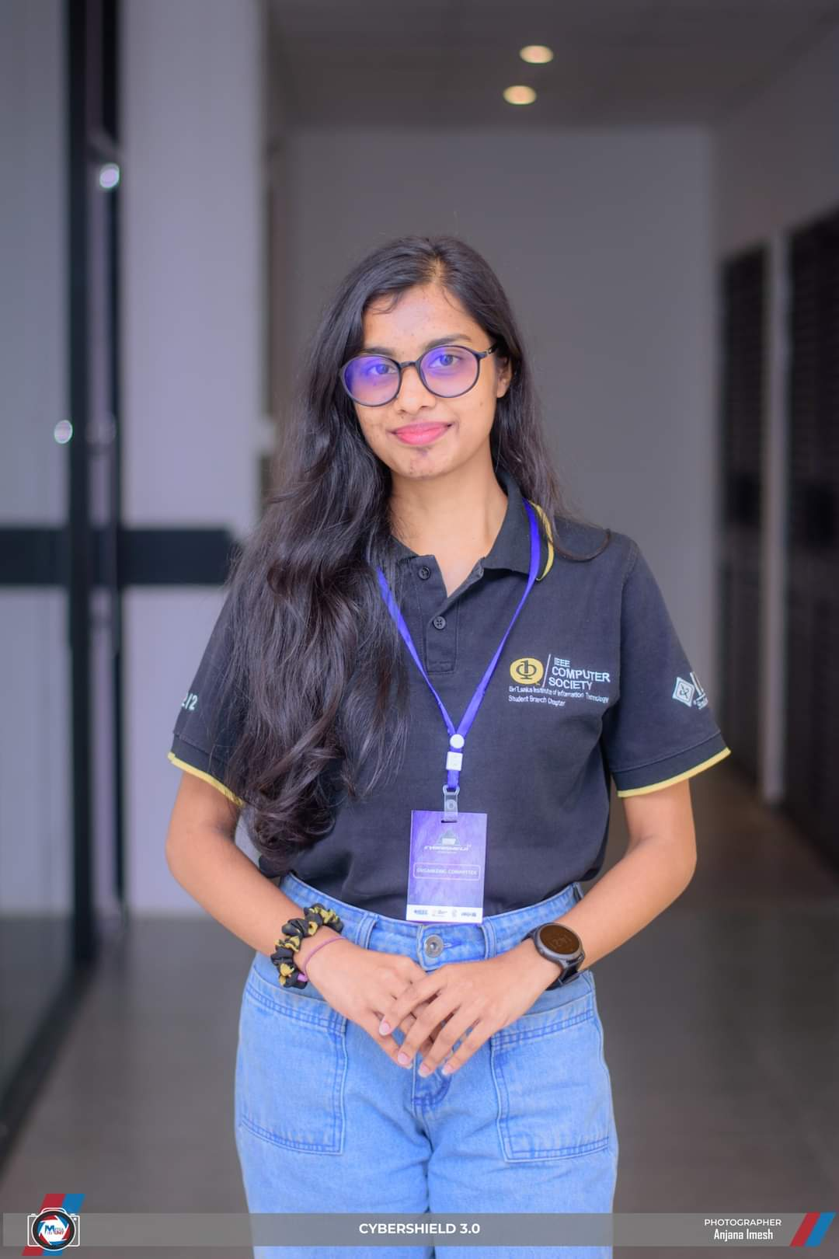
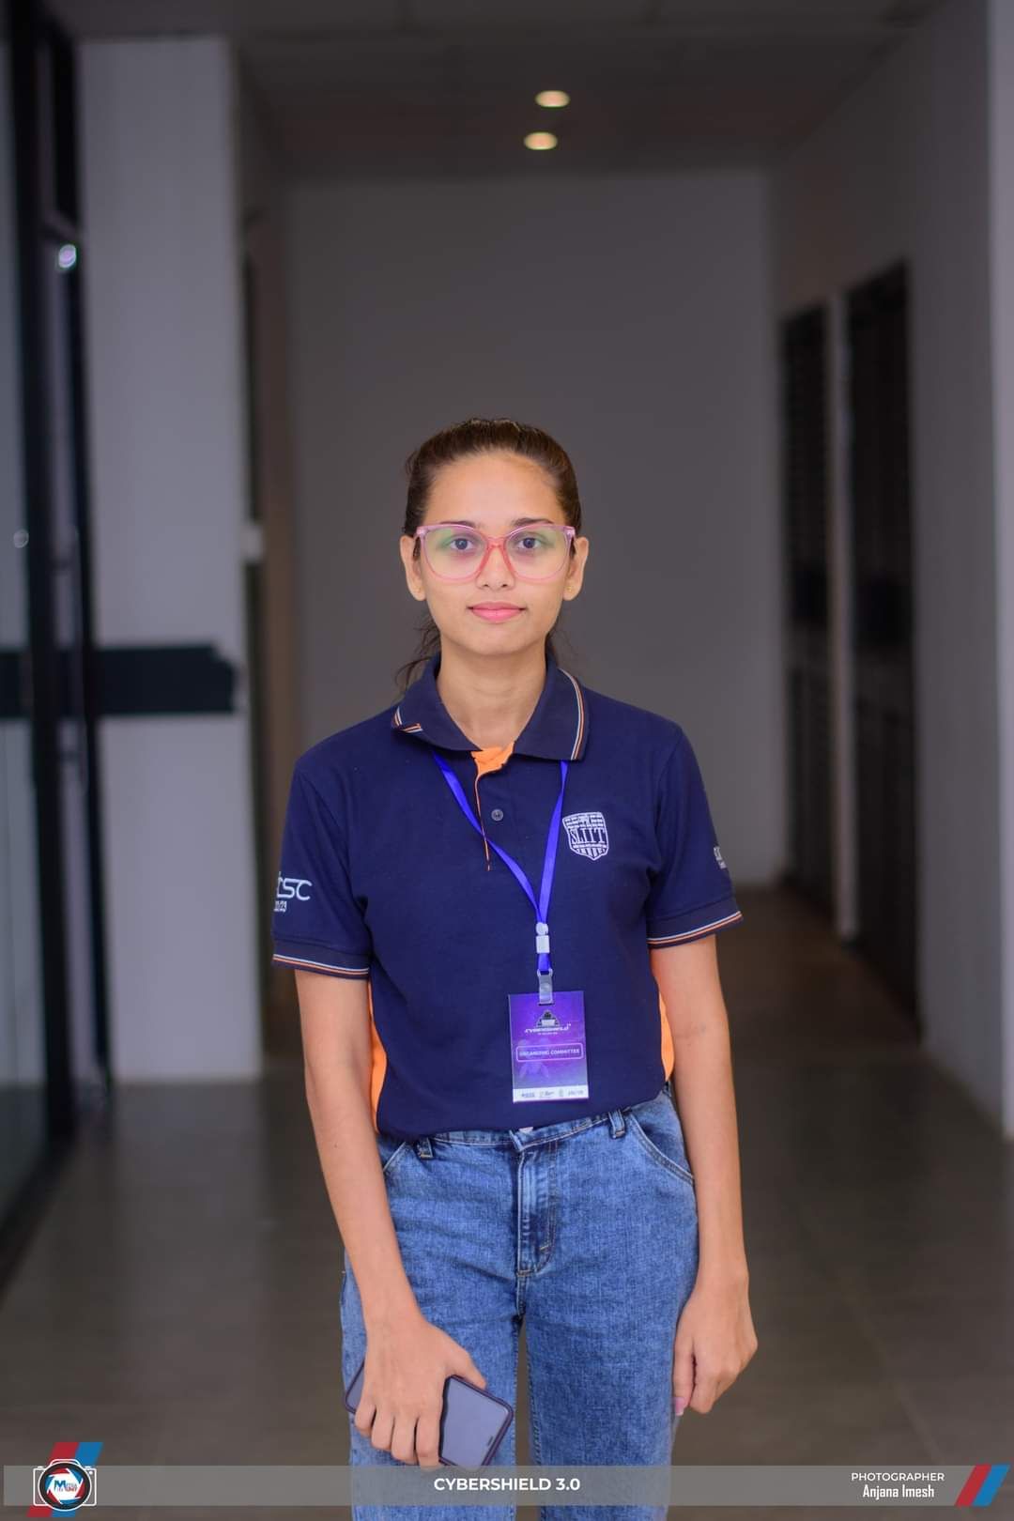

Team
Gunarathna N.W.P.B.M
Thennakoon T.M.I.C
Anjalie P.M.R.S
Pinsara A.R.D
IT21319792
IT21170966
IT21167232
IT 21158186
Marketing Head

Slide 5
Team
Pinsara A.R.D
VIDEO BASED MOCKUP EXAM
IT 21158186
Thennakoon T.M.I.C
ASSESS STRESS IN GAMIFIED ENVIRONMENT
IT 21170966
Anjalie P.M.R.S
ASSESS CODE COMPLEXITY AND MAINTAINABILITY
IT 21167232
Gunarathna N.W.P.B.M
ASSESS CONFIDENCE LEVEL FROM VOICE FREQUENCY
Marketing Head
IT 21319792

Slide 6


RESEARCH OBJECTIVES
To develop an automated interview process tool that provides a comprehensive and objective assessment of candidates by evaluating personality traits, technical skills, problem-solving abilities, code complexity, maintainability, and non-verbal communication aspects.
To create algorithms that assess personality traits and confidence levels from vocal features.
Integrate emotional analysis and gamified assessments for evaluate technical skills.
Assesses the complexity and maintainability of code submissions.
create video-based mockup tests and cover letters to evaluate candidates’ Background suitability to the company.
Validate the effectiveness of the integrated tool against traditional assessment methods and industry benchmarks.

Slide 7

WHAT THIS SYSTEM WILL EVALUATE
PERSONALITY TRAITS
TECHNICAL SKILLS,
PROBLEM-SOLVING ABILITIES
CODE COMPLEXITY & MAINTAINABILITY
STRESS LEVEL
CONFIDENCE LEVELS
During Interview Process

Slide 8
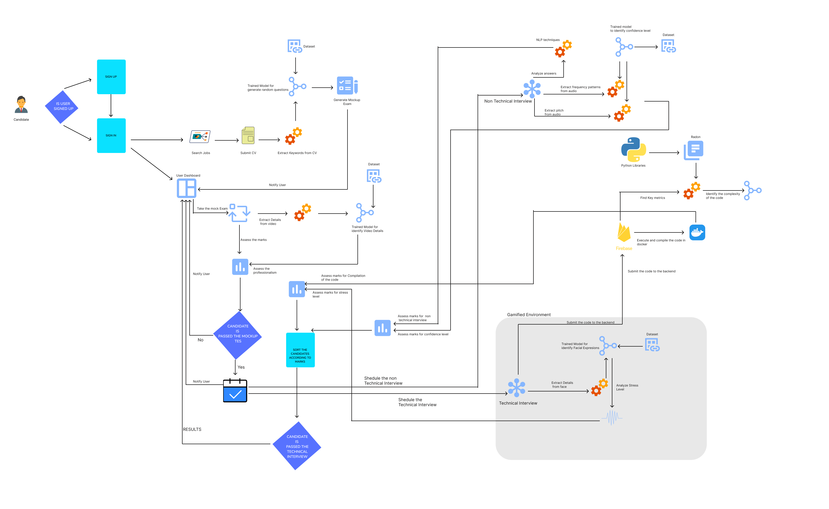
OVERALL SOLUTION

Slide 9
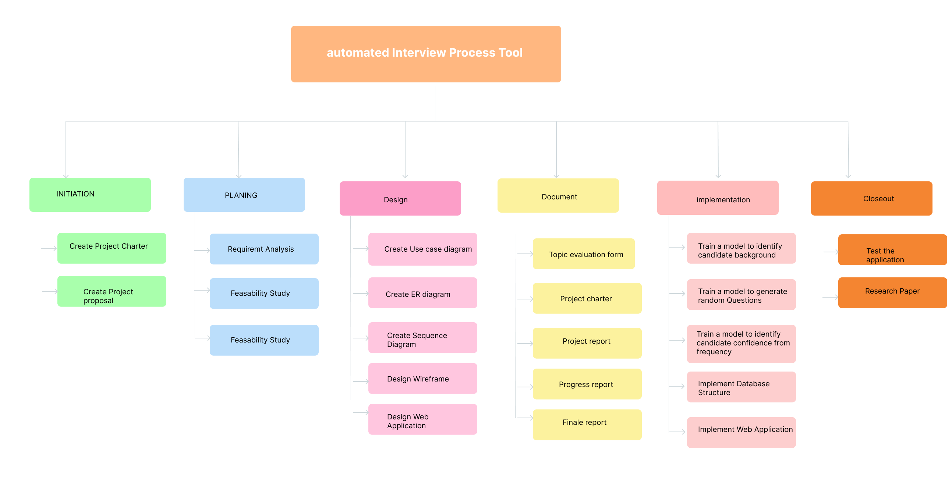
Workload Distribution

Slide 10







01
Front End
02
Back End
Technology Used
03
Data Base
04
Libraries

Slide 11


IT21158186 | Pinsara A.R.D
Specialization : Information Technology
IT21158186 | Pinsara A.R.D | 24-25J-047

Slide 12

INTRODUCTION
"Introducing an innovative system that evaluates candidates primarily on their skills through a video-based mock-up test. Additionally, it assesses grooming, professionalism, and the working environment to provide a comprehensive candidate evaluation."
IT21158186 | Pinsara A.R.D | 24-25J-047

Slide 13

RESEARCH QUESTION
"How effective are video-based mockup tests in shortlisting candidates based on skill evaluation and assessing grooming, professionalism, and working environment? This research aims to address the reliance on subjective evaluations in current methods."
IT21158186 | Pinsara A.R.D | 24-25J-047

Slide 14

RESEARCH GAP
Current interview processes heavily rely on subjective evaluations and traditional metrics, often overlooking the nuanced information embedded in vocal features.
Reference | Research Paper 1 | Research Paper 2 | Research Paper 3 | Proposed Function
Skills Extraction from CV | ✓ | ✓ | X | ✓
Generate Questions related to extracted Skills | ✓ | X | X | ✓
Use of Video-Based Mockup Tests | X | ✓ | X | ✓
Evaluation of professionalism and working environment using machine learning | X | ✓ | X | ✓
Rating skills of candidates automatically | X | X | ✓ | ✓
IT21158186 | Pinsara A.R.D | 24-25J-047

Slide 15



SPECIFIC AND SUB OBJECTIVES
Specific Objective:
•To develop a system that uses video-based mock-up tests to objectively assess candidates' skills. The system will also evaluate grooming, professionalism, and working environment as supplementary criteria.
Sub Objectives:
To identify key skills from candidates' CVs and generate relevant mockup test questions.
To develop machine learning algorithms for assessing grooming, professionalism, and work environment.
To validate the effectiveness of this integrated evaluation system.
IT21158186 | Pinsara A.R.D | 24-25J-047

Slide 16

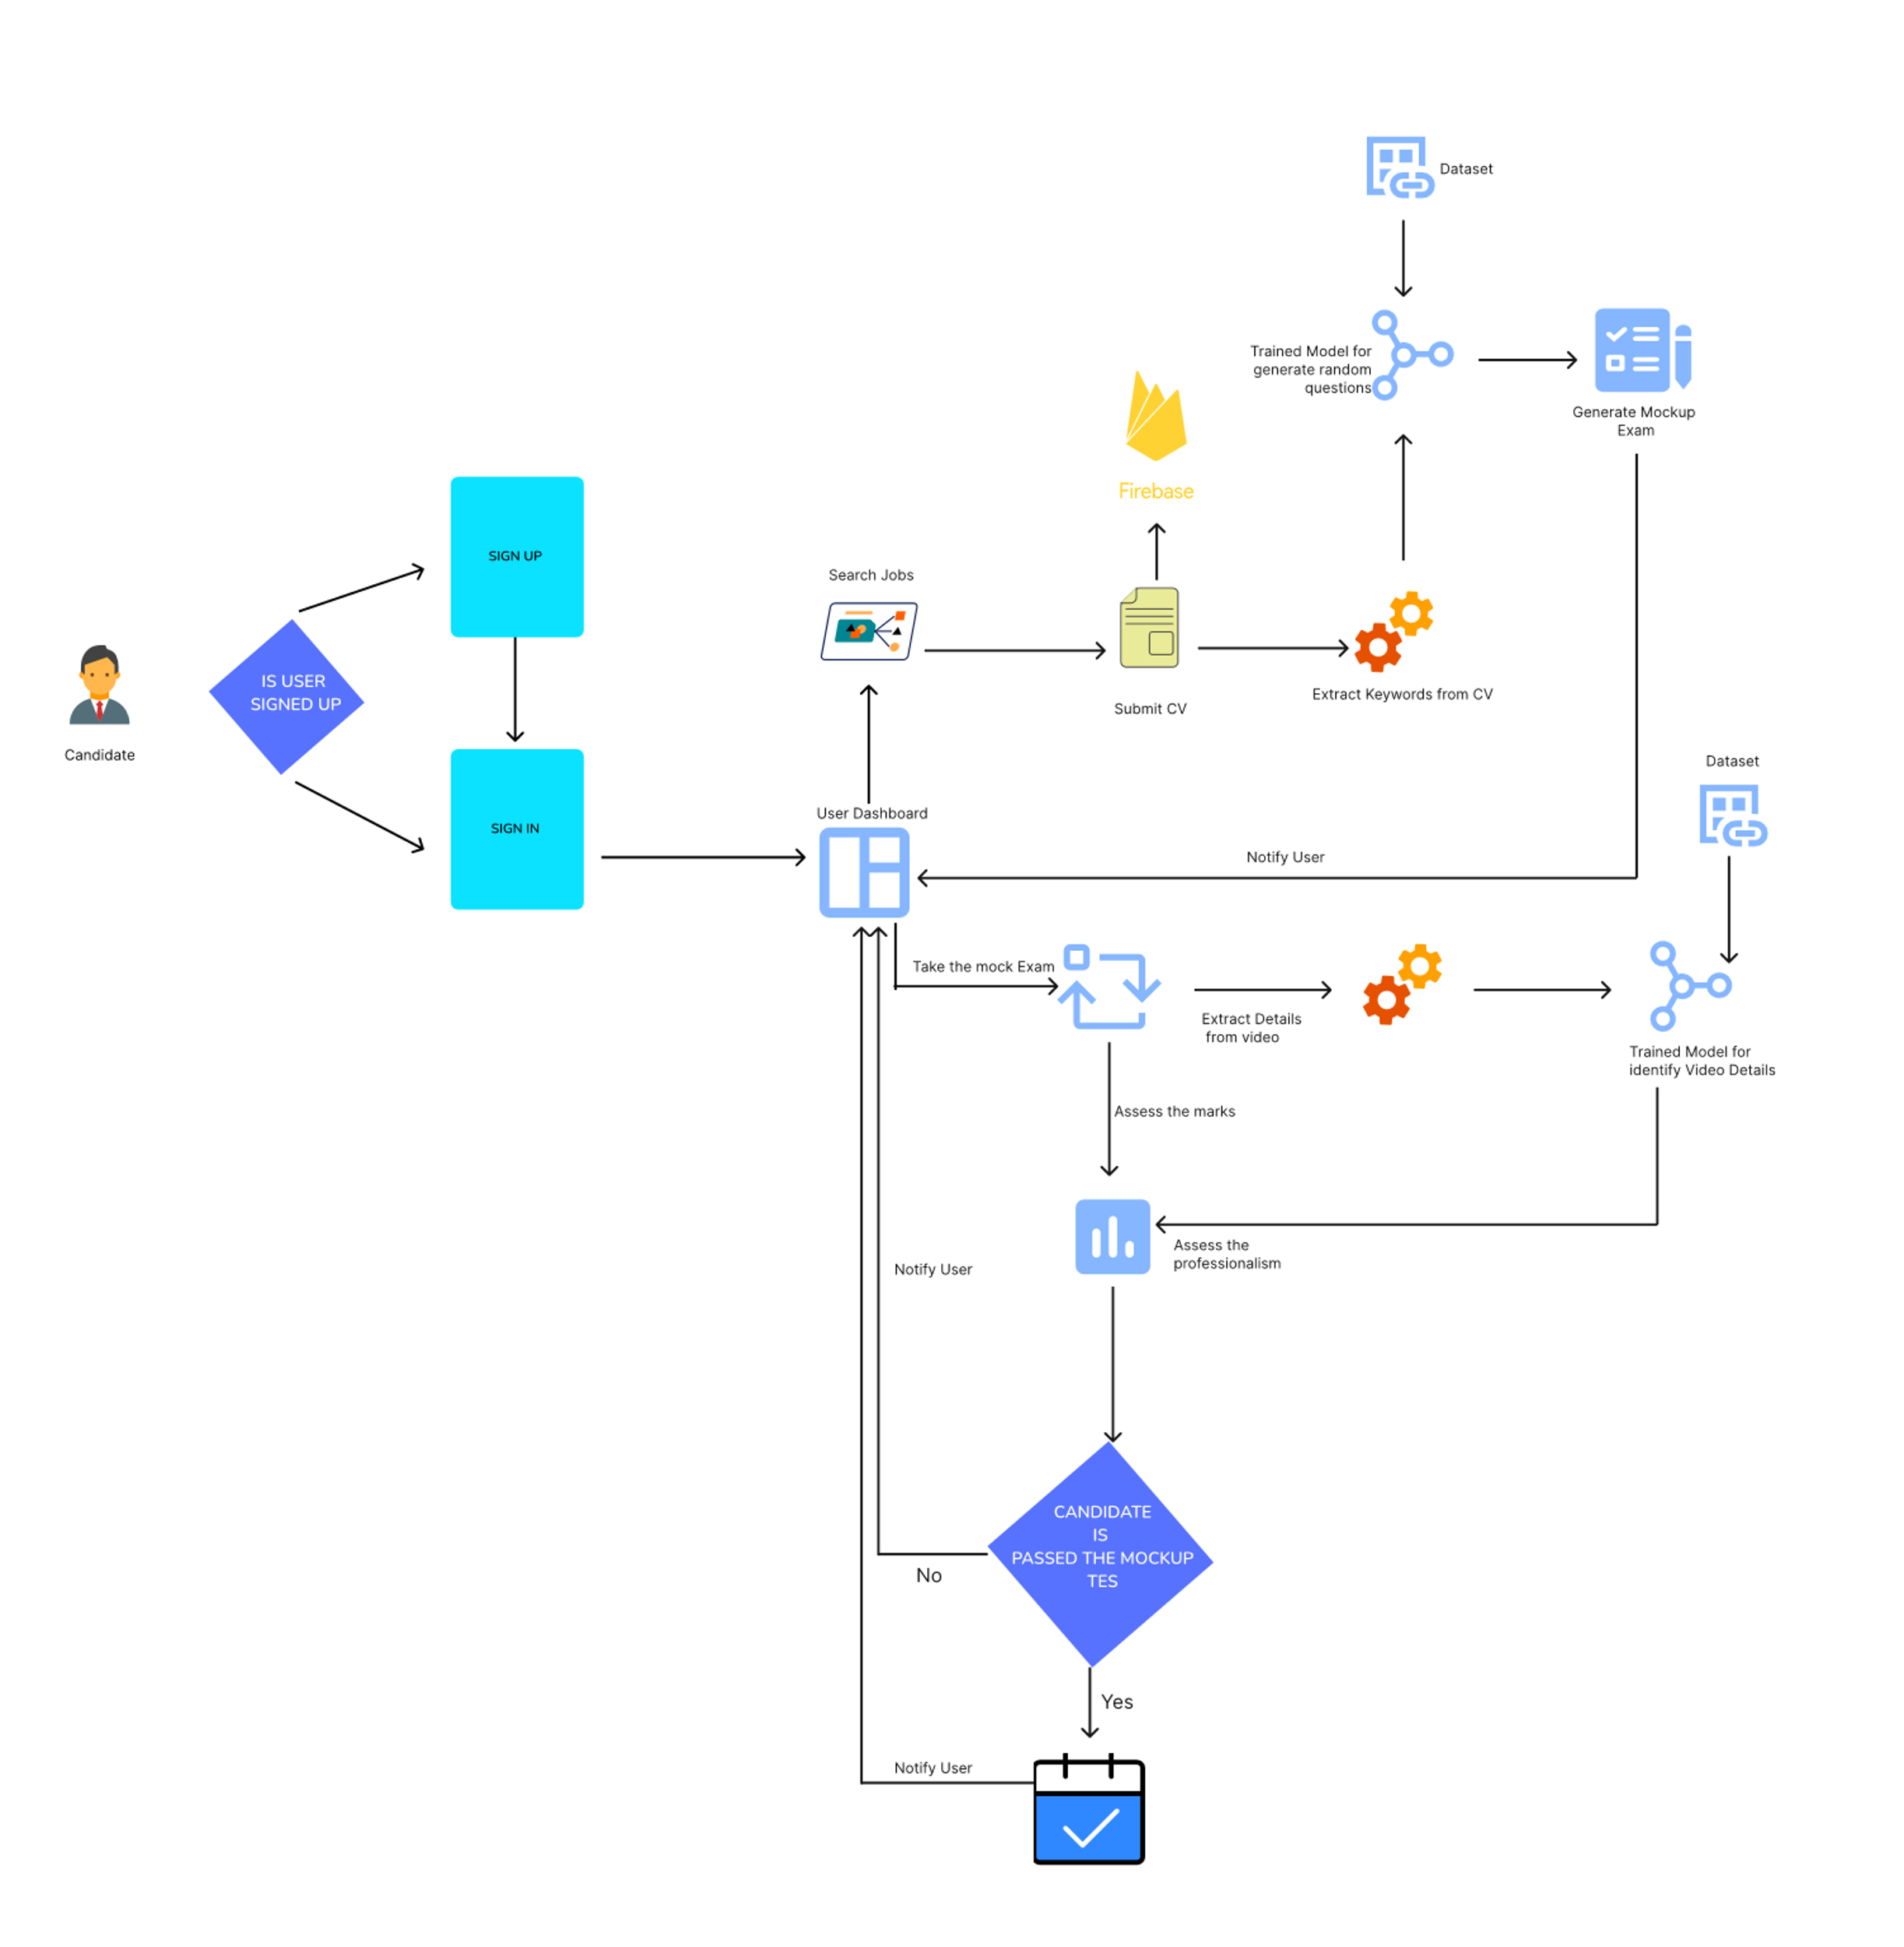
METHODOLOGY
IT21158186 | Pinsara A.R.D | 24-25J-047
System diagram

Slide 17
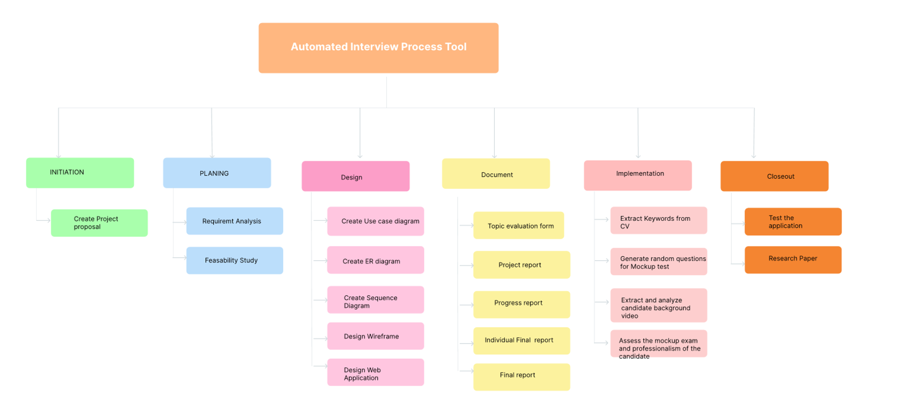
Workload Distribution
IT21167232 | P.M.R.S.Anjalie | 24-25J-047

Slide 18
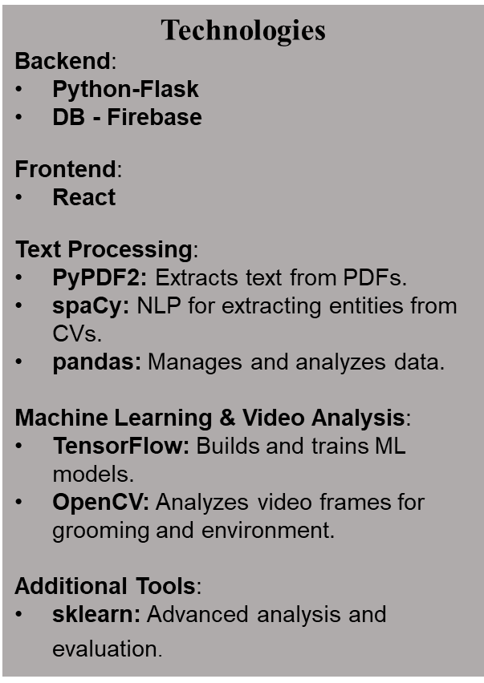
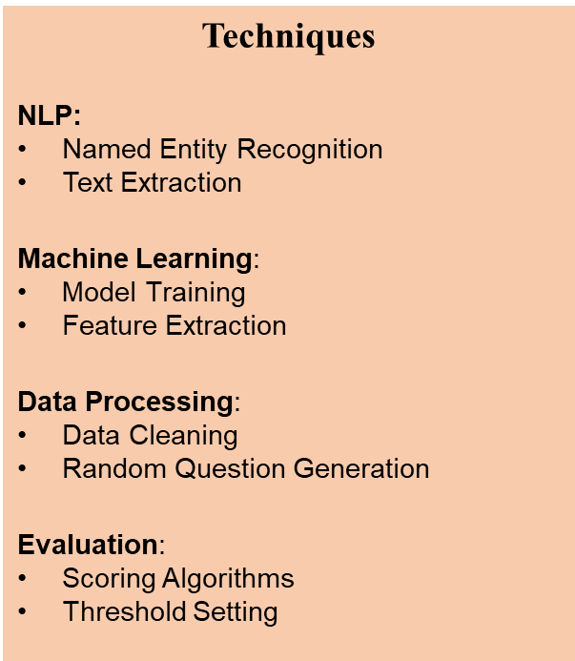
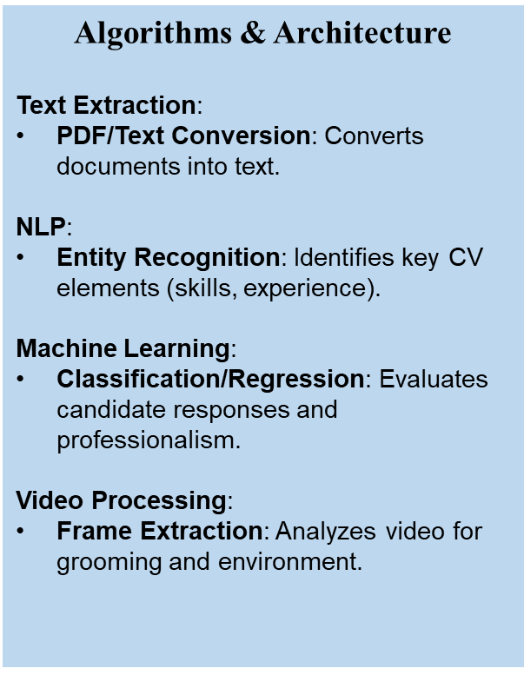
Technologies, Techniques, Algorithms
IT21158186 | Pinsara A.R.D | 24-25J-047

Slide 19
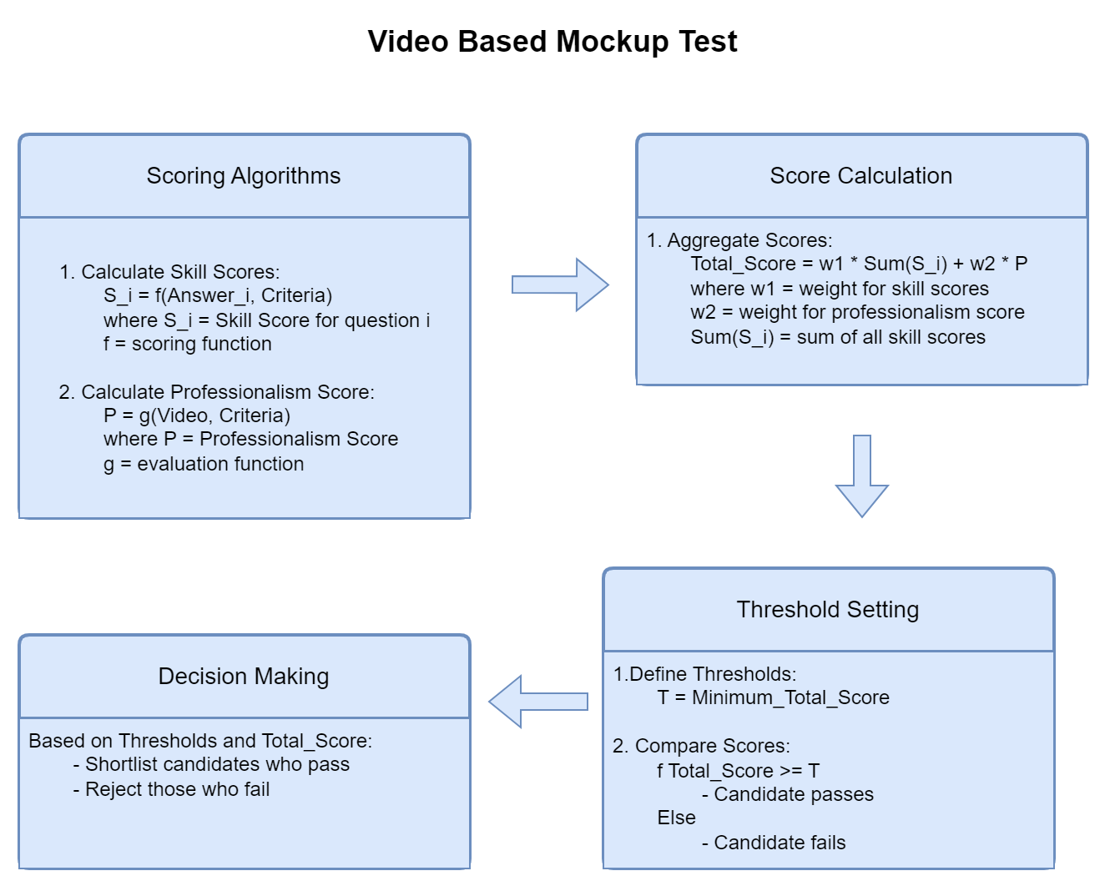


Candidate Evaluation Process
IT21158186 | Pinsara A.R.D | 24-25J-047

Slide 20


System, Personnel, and Software Specification Requirement
 |  | Server | Client Machines
Hardware | Processor | Multi-core CPU (e.g., Intel Xeon or AMD Ryzen) | Dual-core CPU
 | RAM | Minimum 16 GB | Minimum 4 GB
 | Storage | SSD with at least 500 GB of space | At least 10 GB free space
 | Network | High-speed internet connection | Stable internet connection
Security | Data Encryption: | HTTPS for secure data transmission
 | Authentication: | Secure login mechanisms (e.g., JWT or OAuth)
 | Authorization | Role-based access control

Slide 21
REFERENCES
S. Hu et al., "Manual Wiring Measurement of DC Deep Well Grounding Resistance," 2018 IEEE International Conference on High Voltage Engineering and Application (ICHVE), Athens, Greece, 2018, pp. 1-4, doi: 10.1109/ICHVE.2018.8642046. Keywords: Electrodes; Grounding; Electrical resistance measurement; Electric potential; Resistance; Current measurement; Voltage measurement; Compensation method; DC deep well grounding electrode; Manual wiring; Measurement of grounding resistance; Surface potential distribution.
G. Li, Y. Liu, H. Zhao, and H. Cai, "Research on Application of Network System to Nursing Management," 2019 11th International Conference on Measuring Technology and Mechatronics Automation (ICMTMA), Qiqihar, China, 2019, pp. 705-707, doi: 10.1109/ICMTMA.2019.00161. Keywords: Measurement; Mechatronics; Automation; Nursing Management; Network System; Medical Treatment.
S. Yun, J. -M. Kang, I. -M. Kim, and J. Ha, "Deep Artificial Noise: Deep Learning-Based Precoding Optimization for Artificial Noise Scheme," IEEE Transactions on Vehicular Technology, vol. 69, no. 3, pp. 3465-3469, March 2020, doi: 10.1109/TVT.2020.2965959. Keywords: Channel estimation; Precoding; Optimization; Training; MISO communication; Feature extraction; Wireless communication; Artificial noise; Deep learning; Deep neural network; Physical layer security; Precoding.
IT21158186 | Pinsara A.R.D | 24-25J-047

Slide 22

IT21170966 | Thennakoon T.M.I.C.
Specialization : Information Technology
IT21170966 | Thennakoon T.M.I.C.| 24-25J-047

Slide 23
INTRODUCTION
The fusion of emotional analysis with gamified assessments offers a novel approach to evaluating technical skills and problem-solving abilities.
By leveraging emotional cues and interactive, game-based tasks, this method provides a dynamic and engaging way to assess candidates' competencies beyond traditional testing.
IT21170966 | Thennakoon T.M.I.C.| 24-25J-047

Slide 24
RESEARCH GAP
Existing research often focuses on isolated aspects of emotional analysis
or gamified assessments.
Reference | Research Paper 1 | Research Paper 2 | Research Paper 3 | Proposed Function
Emotional Analysis | ✓ | X | ✓ | ✓
Gamified Assessments | X | ✓ | X | ✓
Integration of Emotional and Performance Data | X | X | ✓ | ✓
Evaluation of Technical Skills | X | ✓ | X | ✓
Evaluation of Problem-Solving Abilities | X | ✓ | X | ✓
IT21170966 | Thennakoon T.M.I.C.| 24-25J-047

Slide 25

RESEARCH QUESTION
How effective is the integration of emotional analysis and gamified assessments in evaluating technical skills and problem-solving abilities of candidates?
IT21170966 | Thennakoon T.M.I.C.| 24-25J-047

Slide 26

SPECIFIC AND SUB OBJECTIVES
Specific Objective:
To develop a system that evaluates technical skills and problem-solving abilities while using emotional analysis within a gamified environment.
Sub Objectives:
To enhance candidate's experience
To design gamified assessments that accurately evaluate technical skills.
Measure stress levels during problem-solving tasks
IT21170966 | Thennakoon T.M.I.C.| 24-25J-047

Slide 27
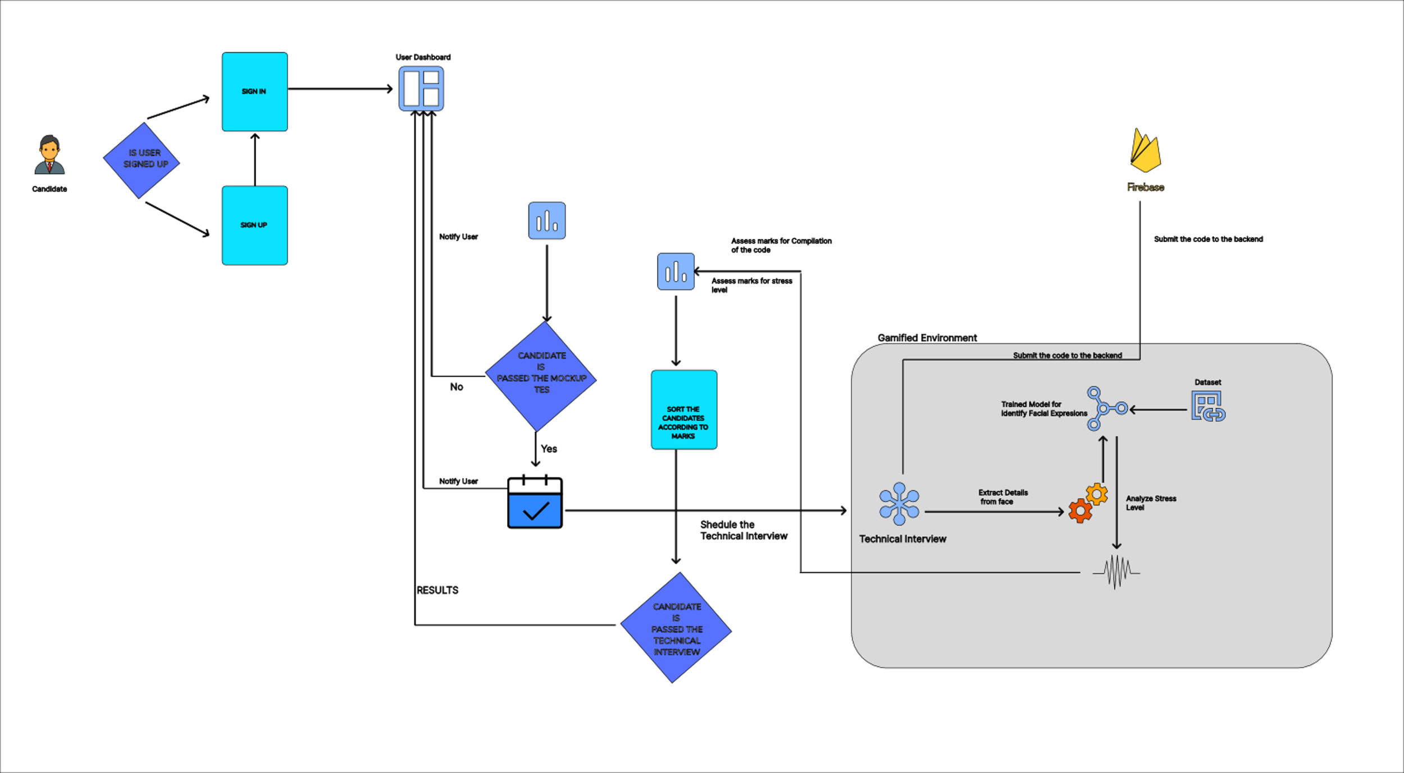
METHODOLOGY
IT21170966 | Thennakoon T.M.I.C.| 24-25J-047
System diagram

Slide 28
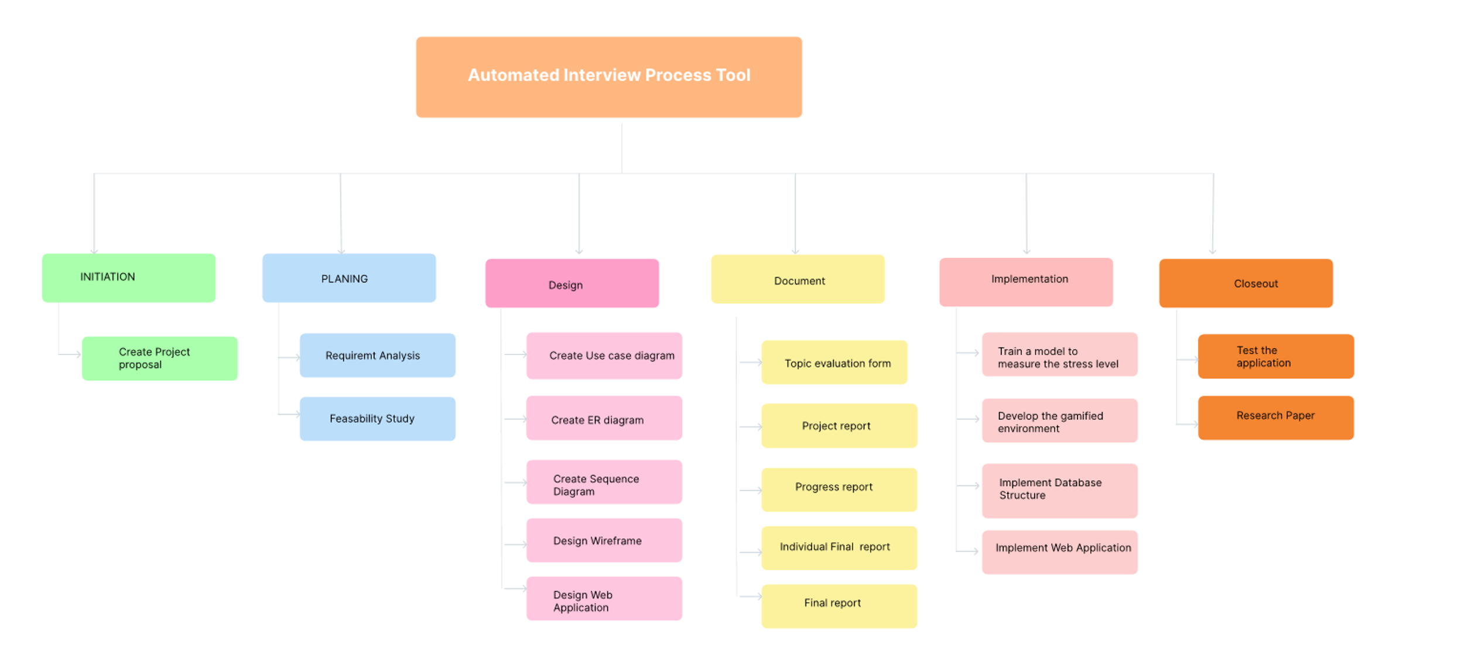
Workload Distribution
IT21170966 | Thennakoon T.M.I.C.| 24-25J-047

Slide 29



System and Software Specification Requirement
Functional Requirements
Non-Functional Requirements
Real-time Facial Expression Analysis
Stress Level Measurement
Problem-Solving Skill Assessment
Integration with Gamified Environment
Data Storage and Management
Software Requirements
User-Friendly Interface
Real-Time Processing
High Accuracy and Reliability
Security and Privacy
Jupyter Notebook
Unity
IntelliJ Idea
IT21170966 | Thennakoon T.M.I.C.| 24-25J-047
System diagram

Slide 30



Technologies, Techniques, Algorithms
Technologies
Techniques
Algorithms & Architecture
ReactJS
Python
Tensorflow
Firebase
Unity
OpenCv
Transfer Learning
Data Augmentation
Convolutional Neural Network
(CNN)
IT21170966 | Thennakoon T.M.I.C.| 24-25J-047
System diagram

Slide 31
REFERENCES
[1] J. Smith, R. Brown, and L. Wang, "Real-Time Emotional Analysis in Online Learning Environments," IEEE Transactions on Affective Computing, vol. 12, no. 3, pp. 456-467, July-Sept. 2023, doi: 10.1109/TAFFC.2023.1234567.​
​
[2] A. Johnson and M. Lee, "Gamified Assessment Techniques for Evaluating Technical Skills in Remote Education," in Proc. 2022 IEEE Global Engineering Education Conference (EDUCON), Tunis, Tunisia, 2022, pp. 234-239, doi: 10.1109/EDUCON.2022.1234567.
[3] K. Patel, D. Nguyen, and P. Garcia, "Integrating Emotional Analysis with Performance Metrics in E-learning Systems," International Journal of Educational Technology in Higher Education, vol. 18, no. 1, pp. 78-89, Jan. 2024, doi: 10.1007/s12345-024-1234-x.
IT21170966 | Thennakoon T.M.I.C.| 24-25J-047

Slide 32
IT21167232 | P.M.R.S Anjalie
Specialization : Information Technology
IT21167232 | P.M.R.S Anjalie.| 24-25J-047

Slide 33
INTRODUCTION
Evaluating code complexity and maintainability is crucial in determining a candidate's coding proficiency in a technical role.
By developing an automated tool to assess these factors, we can streamline the interview process and ensure a higher quality of candidate selection.
IT21167232 | P.M.R.S.Anjalie | 24-25J-047

Slide 34
RESEARCH QUESTION
How can the complexity and maintainability of code be effectively assessed to shortlist candidates during a technical interview?
IT21167232 | P.M.R.S.Anjalie | 24-25J-047

Slide 35
RESEARCH GAP
Current research provides individual metrics for code complexity and maintainability but lacks using 3 metrics for assess the code.
Reference | Research Paper 1 | Research Paper 2 | Research Paper 3 | Proposed Function
Code Complexity Assessment | ✓ | ✓ | ✓ | ✓
Code Maintainability Assessment | ✓ | ✓ | X | ✓
Using CC, WCC ,CFS | X | X | X | ✓
Automated Tool for Interview Use | X | X | X | ✓
Validation Against Industry Standards | X | ✓ | X | ✓
IT21167232 | P.M.R.S.Anjalie | 24-25J-047

Slide 36
SPECIFIC AND SUB OBJECTIVES
Specific Objective:
To create a tool that assesses the complexity and maintainability of code submissions
during technical interviews.
Sub Objectives:
To identify key metrics for code complexity and maintainability.
To develop algorithms that analyze code submissions based on these metrics.
To validate the tool against industry-standard benchmarks and expert evaluations.
IT21167232 | P.M.R.S.Anjalie | 24-25J-047

Slide 37
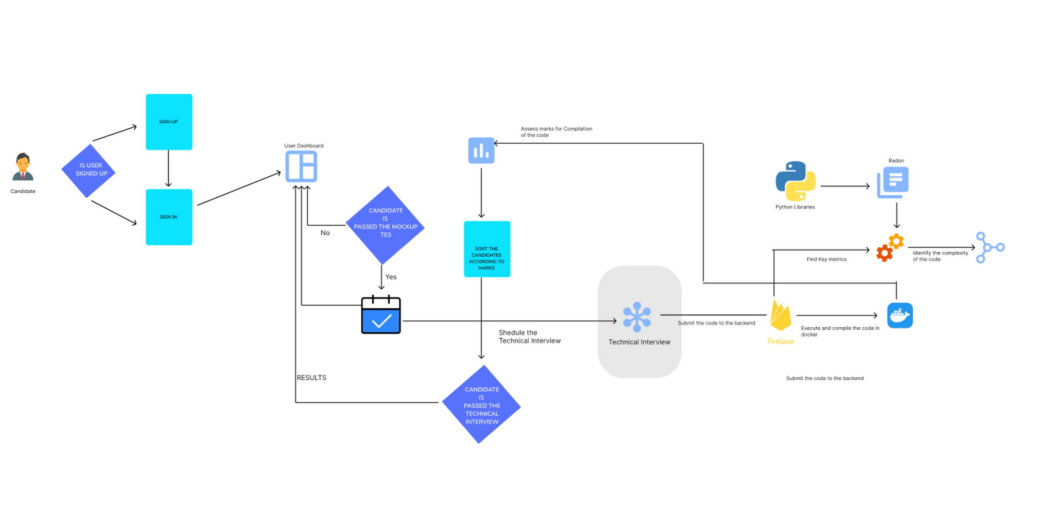
METHODOLOGY
IT21167232 | P.M.R.S.Anjalie | 24-25J-047
System diagram

Slide 38

Workload Distribution
IT21167232 | P.M.R.S.Anjalie | 24-25J-047

Slide 39
System and Software Specification Requirement
Functional Requirements
Non-Functional Requirements
Complexity Metrics Calculation
Code Input
Multi Language support
Software Requirements
Performance
Accuracy
High Accuracy and Reliability
Security and Privacy
VS Code
Docker
IT21167232 | P.M.R.S.Anjalie | 24-25J-047
System diagram

Slide 40
Technologies, Techniques, Algorithms
Technologies
Techniques
Algorithms & Architecture
ReactJS
Python
Firebase
Radon
Docker
Code Parsing
Cyclomatic Complexity
Cognitive Complexity
Weighted Cyclomatic Complexity
IT21167232 | P.M.R.S.Anjalie | 24-25J-047
System diagram

Slide 41
REFERENCES
U. Chhillar and S. Bhasin, "A New Weighted Composite Complexity Measure for Object-Oriented Systems," Department of Computer Science, Kurukshetra University, Kurukshetra,Haryana, India.
J. Shao and Y. Wang, "A New Measure of SoŌware Complexity Based on CogniƟve Weights,"Proceedings of the Third InternaƟonal Conference on CogniƟve InformaƟcs (ICCI'04), Victoria,BC, Canada, 2004, pp. 60-70.
IT21167232 | P.M.R.S.Anjalie | 24-25J-047

Slide 42
IT21319792 | Gunarathna N.W.P.B.M.
Specialization : Information Technology
IT21319792 | Gunarathna N.W.P.B.M| 24-25J-047

Slide 43

INTRODUCTION
The evaluation of non-verbal cues such as tone, pitch, and frequency provides deep insights into an individual's personality and confidence.
By analyzing these vocal features, we can derive valuable information that complements traditional interview assessments.
IT21319792 | Gunarathna N.W.P.B.M| 24-25J-047

Slide 44



STATISTICS
80%
candidates experience anxiety during interviews, which can significantly alter their vocal pitch and frequency
20%
Around
of interviewers may unintentionally let their biases influence their perception of a candidate’s vocal confidence
IT21319792 | Gunarathna N.W.P.B.M| 24-25J-047

Slide 45




RESEARCH QUESTION
How can tone, pitch, and frequency analysis accurately assess a candidate's personality and confidence during an interview?
How this would help the IT industry and how this will be a Innovative approach
IT21319792 | Gunarathna N.W.P.B.M| 24-25J-047

Slide 46
RESEARCH GAP
Current interview processes heavily rely on subjective evaluations and traditional metrics, often overlooking the nuanced information embedded in vocal features.
Reference | Research Paper 1 | Research Paper 2 | Research Paper 3 | Proposed Function
Analysis of Tone | ✓ | X | ✓ | ✓
Analysis of Pitch | ✓ | X | X | ✓
Analysis of Frequency | X | ✓ | X | ✓
Correlation with Personality Traits | X | X | ✓ | ✓
Confidence Level Indicators | X | X | X | ✓
IT21319792 | Gunarathna N.W.P.B.M| 24-25J-047

Slide 47
SPECIFIC AND SUB OBJECTIVES
Specific Objective:
To develop an algorithm that evaluates personality and confidence using tone, pitch, and frequency during interviews.
Sub Objectives:
Identify key voice features that correlate with personality traits and confidence levels.
Collect and preprocess voice data for analysis.
Train and validate machine learning models on the voice data.
Integrate the voice analysis tool into the automated interview process.
IT21319792 | Gunarathna N.W.P.B.M| 24-25J-047

Slide 48
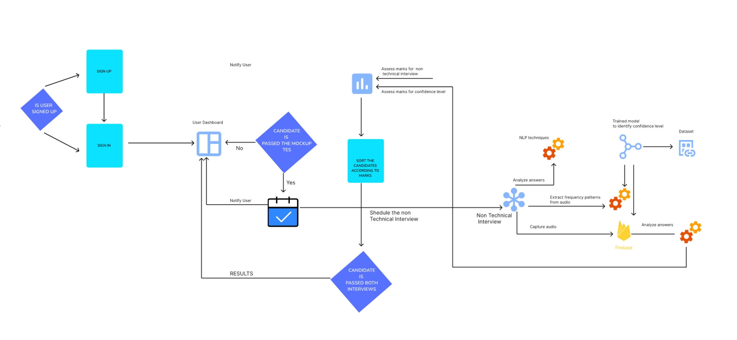
METHODOLOGY
IT21319792 | Gunarathna N.W.P.B.M| 24-25J-047
System diagram

Slide 49
System and Software Specification Requirement
Functional Requirements
Non-Functional Requirements
Audio Input
Frequency Analyze
Confidence Scoring
Feedback and reporting
Software Requirements
Performance
Accuracy
High Accuracy and Reliability
Security and Privacy
VS Code
Jupitor Notebook
IT21319792 | Gunarathna N.W.P.B.M| 24-25J-047
System diagram

Slide 50
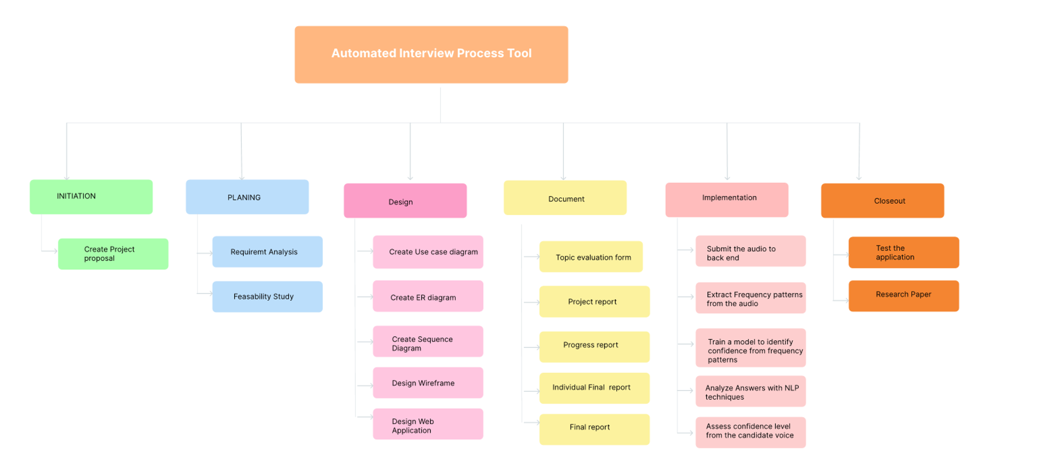
Workload Distribution
IT21319792 | Gunarathna N.W.P.B.M| 24-25J-047

Slide 51
Technologies, Techniques, Algorithms
Technologies
Techniques
Algorithms & Architecture
ReactJS
Python
Firebase
Librosa
Signal Processing
Feature Extraction
Fast Fourier Transform (FFT)
MFCC Extraction
Regression Models
IT21319792 | Gunarathna N.W.P.B.M| 24-25J-047
System diagram

Slide 52
REFERENCES
S. P. Dubagunta and M. Magimai.-Doss, "Segment-level Training of ANNs Based on Acoustic Confidence Measures for Hybrid HMM/ANN Speech Recognition," ICASSP 2019 - 2019 IEEE International Conference on Acoustics, Speech and Signal Processing (ICASSP), Brighton, UK, 2019, pp. 6435-6439, doi: 10.1109/ICASSP.2019.8683513
D. Yu, J. Li, and L. Deng, "Calibration of Confidence Measures in Speech Recognition," IEEE Transactions on Audio, Speech, and Language Processing, vol. 19, no. 8, pp. 2461-2473, Nov. 2011, doi: 10.1109/TASL.2011.2141988.
B. Ziółko, T. Jadczyk, D. Skurzok, and M. Ziółko, "Confidence measure by substring comparison for automatic speech recognition," 2012 International Conference on Audio, Language and Image Processing, Shanghai, China, 2012, pp. 314-318, doi: 10.1109/ICALIP.2012.6376632.
IT21319792 | Gunarathna N.W.P.B.M| 24-25J-047

Slide 53
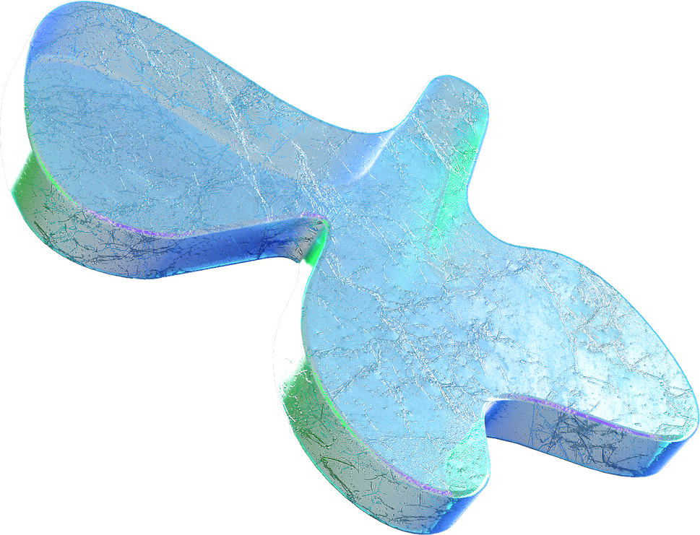
Do you have
any questions?

